Slide 1

Capstone Project:
Increasing user retention by Predicting Churn
Telecom companies face a critical challenge: customer churn. This presentation outlines our strategy to predict and proactively prevent customer attrition, ensuring sustained revenue and customer loyalty.
By : Under the Guidance of :
Indrapal Singh (Roll Number :30) Mr. Ishan Marwah
Anuj Soni (Roll Number :29)
Khushi Dasra (Roll Number :31) Conducted by :
Devdatt Mishra (Roll Number :28) DSSC
K. Yukti (Roll Number :32)

Slide 2

PROBLEM STATEMENT
Understanding the Impact of Customer Churn
Customer churn significantly erodes revenue and market share for telecom providers. Identifying at-risk customers is paramount for implementing targeted retention strategies.
Increased Costs
Direct revenue loss from departing customers.
Increased acquisition costs to replace lost subscribers.
Negative impact on brand perception and customer lifetime value.
Reduced Revenue
Lower CLV
Decreased Market Share
Our objective is to develop a robust machine learning model capable of accurately classifying potential churners versus non-churners, enabling timely intervention.

Slide 3




DATA & APPROACH
Building the Foundation: Data Integration and Feature Engineering
Comprehensive Data Merge
We integrated four distinct datasets: customer demographics, usage patterns, complaint records, and billing history to form a holistic view of each subscriber.
Strategic Feature Engineering
Key features were engineered, including complaint metrics (frequency, type), detailed usage patterns (data, call minutes), and billing history (average spend, payment delays).
Master Dataset Creation
A master dataset was constructed comprising 8 numerical and 2 categorical features, carefully selected to capture critical indicators of churn.
Robust Train-Test Split
The master dataset was split into an 80-20 ratio for training and testing, ensuring the model's ability to generalize to unseen data.

Slide 4

MODEL DEVELOPMENT
Selecting the Optimal Predictive Model
We evaluated three prominent machine learning algorithms to identify the most effective for churn prediction:
Logistic Regression: A baseline for binary classification.
Decision Tree: Interpretable, captures non-linear relationships.
Random Forest: Ensemble method for enhanced accuracy and robustness.
Hyperparameter tuning with GridSearchCV was crucial for optimizing model performance.
The Random Forest model emerged as the top performer, achieving a 72% cross-validation accuracy and an impressive 80% accuracy on the prediction dataset with optimized parameters (n_estimators=200, max_depth=5).

Slide 5

TECH STACK & DEPLOYMENT
From Model to Interactive Application
Python Ecosystem
Machine Learning Core
Leveraged pandas for data manipulation, numpy for numerical operations, and scikit-learn for machine learning.
Implemented RandomForestClassifier with GridSearchCV for robust model training and optimization.
Streamlit Web Application
Model Serialization
Deployed an intuitive and interactive web application using Streamlit for real-time churn predictions.
Utilized joblib for efficient serialization and deserialization of the trained machine learning model.
The interactive Streamlit dashboard enables stakeholders to input customer data and receive instant churn probability scores, enhancing decision-making.

Slide 6
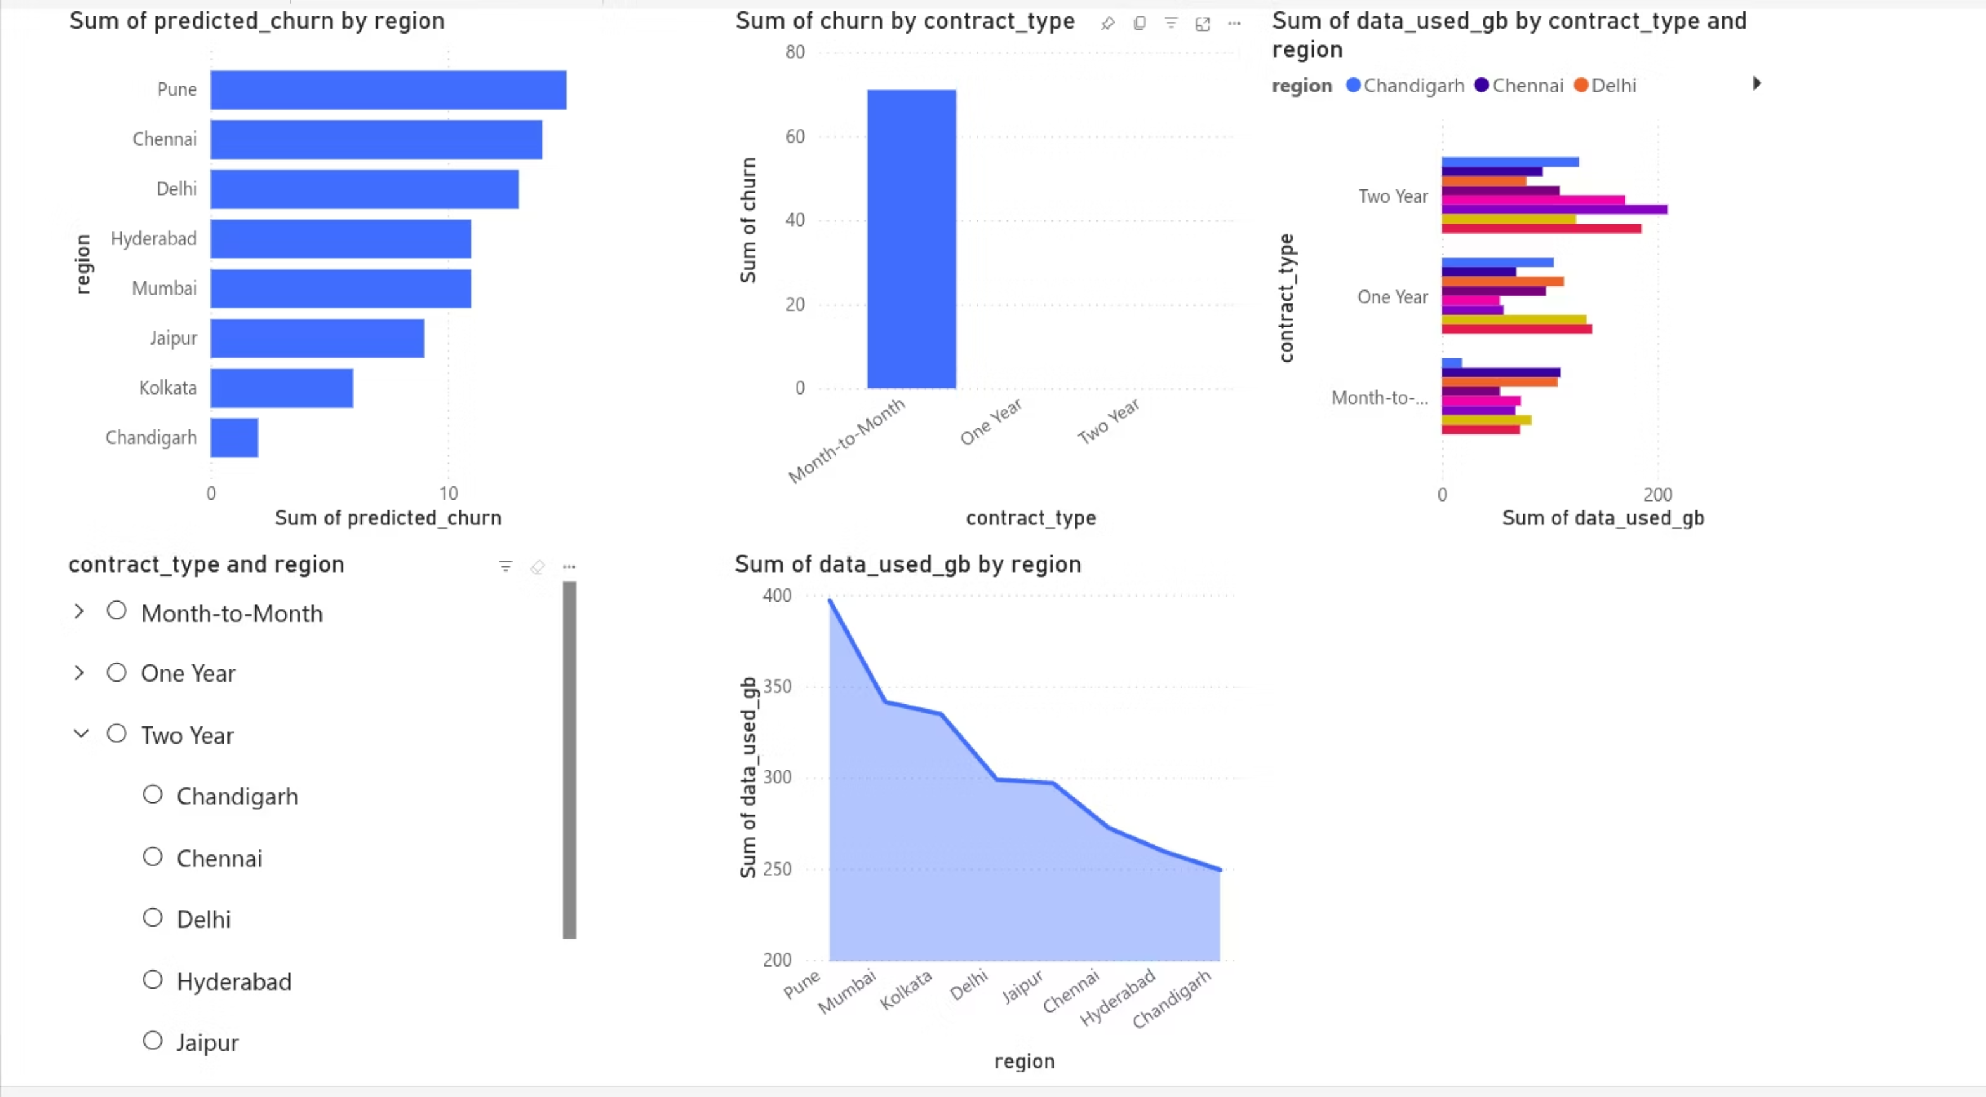
INTERACTIVE DASHBOARD
Visualizing Churn: Our Power BI Dashboard
Our interactive Power BI dashboard provides a dynamic view of churn prediction. Users can explore key metrics, filter by customer segments, and understand the driving factors behind potential churn.
This dashboard empowers business users to proactively identify at-risk customers, allowing for timely and targeted interventions to improve retention rates and safeguard revenue.

Slide 7

Thank You!

